Slide 1
Year 12 Summer Transition Task
Research Task Unit 22

Slide 2
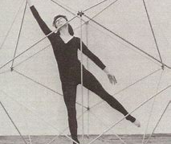
Summer Transition Task (Rudolf Laban):
Unit 22
Please conduct research into Rudolf Laban, focusing on the following things:
Background information / History
Development of components of movement RADS
Laban's 8 efforts
Laban Notation
Any other information

Slide 3
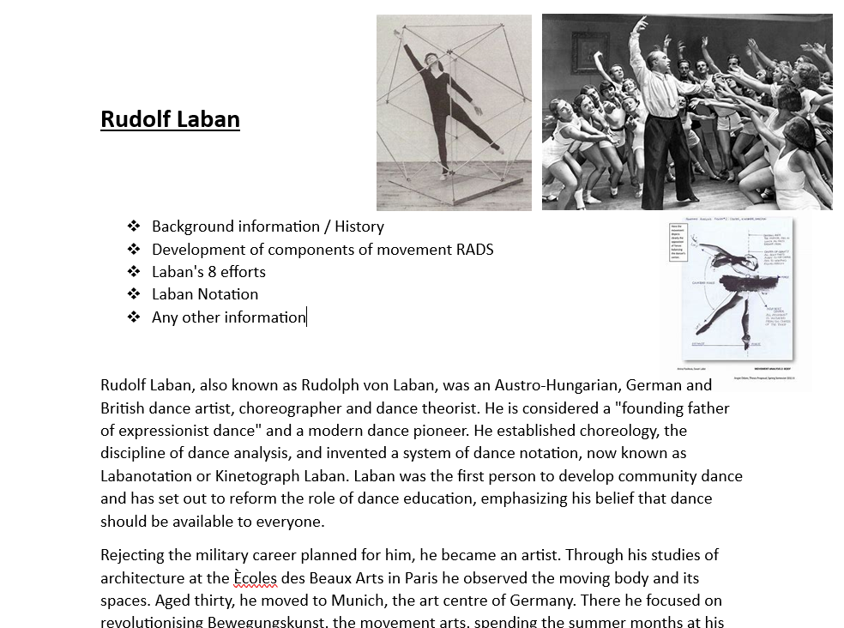
Please present in a word document format such as the one here:
Please email your work to Mrs Hunt ahunt@clcc.college and Mrs Howden showden@clcc.college

