Slide 1


Year 11-12
Transition Pack for
A-Level Biology
Get ready for A-level!
A guide to help you get ready for A-level Biology, including everything from topic guides to days out and online learning courses.
Commissioned by The PiXL Club Ltd. April 2016
© Copyright The PiXL Club Ltd, 2016
This resource is strictly for the use of member schools for as long as they remain members of The PiXL Club. It may not be copied, sold nor transferred to a third party or used by the school after membership ceases. Until such time it may be freely used within the member school.
All opinions and contributions are those of the authors. The contents of this resource are not connected with nor endorsed by any other company, organisation or institution.
www.pixl.org.uk The PiXL Club Ltd, Company number 07321607
Please note: these resources are non-board specific. Please direct your students to the specifics of where this knowledge and skills most apply.

Slide 2

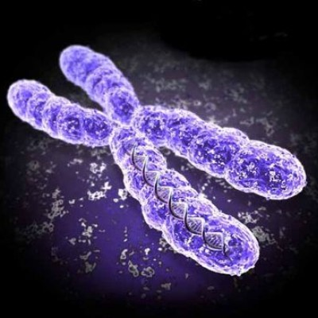
Transition Pack for
A-level Biology
This pack contains a programme of activities and resources to prepare you to start A-level Biology at the end of August. It is aimed to be used after you complete your GCSE examinations, throughout the remainder of the Summer term and over the Summer Holidays to help you be ready to start your course.
https://www.distance-education-academy.com/wp-content/uploads/2013/06/biology-a-level-course.jpg
You should complete all 3 tasks in this booklet.
Task 1: Pre-knowledge topics
Select 4 options from the given list to help you revise key areas from your GCSE Biology. Consider improving areas you find more challenging.
Task 2: Extending your knowledge
Select from options to engage with Biology outside the classroom.
Task 3: A-level Biology Transition Quiz
Complete the quiz. Mark and upgrade your own answers using a purple pen.
Hand in – Week Beginning August 26th 2025
Materials adapted by A Hayes June 2024 Countesthorpe Academy using resources from PiXL.
© Copyright The PiXL Club Ltd, 2016

Slide 3
Task 1: Pre-Knowledge Topics
A level Biology will use your knowledge from GCSE and build on this to help you understand new and more demanding ideas. Select 4 of the following tasks to complete to make sure your biology knowledge is up to date, and that you are ready to start studying:
Option A: DNA and the Genetic Code
In living organisms, nucleic acids (DNA and RNA) have important roles and functions related to their properties. The sequence of bases in the DNA molecule determines the structure of proteins, including enzymes. The double helix and its four bases store the information that is passed from generation to generation. The sequence of the base pairs, adenine, thymine, cytosine and guanine tell ribosomes in the cytoplasm how to construct amino acids into polypeptides and produce every characteristic we see. DNA can mutate leading to diseases including cancer and, sometimes, anomalies in the genetic code are passed from parents to babies in diseases such as cystic fibrosis or can be developed in unborn foetuses such as Downs Syndrome.
Read the information on these websites (you could make more Cornell notes if you wish):
DNA, genes and chromosomes - DNA and inheritance – WJEC - GCSE Biology (Single Science) Revision - WJEC - BBC Bitesize
DNA & the Genome (6.1.4) | AQA GCSE Biology Revision Notes 2018 | Save My Exams
And take a look at these videos:
http://ed.ted.com/lessons/the-twisting-tale-of-dna-judith-hauck
http://ed.ted.com/lessons/where-do-genes-come-from-carl-zimmer
Suggested Task:
Produce a wall display to put up in your classroom in September. You might make a poster or do this using PowerPoint or similar. Your display should use images, keywords and simple explanations to:
Define gene, chromosome, DNA and base pair
Describe the structure and function of DNA and RNA
Explain how DNA is copied in the body
Outline some of the problems that occur with DNA replication and what the consequences of this might be.
Option B: Evolution
The transfer of genetic information from one generation to the next can ensure continuity of species or lead to variation within a species and possible formation of new species. Reproductive isolation can lead to accumulation of different genetic information in populations potentially leading to formation of new species (speciation). Sequencing projects have read the genomes of organisms ranging from microbes and plants to humans. This allows the sequences of the proteins that derive from the genetic code to be predicted. Gene technologies allow study and alteration of gene function in order to better understand organism function and to design new industrial and medical processes.
Read the information on these websites (you could make more Cornell notes if you wish):
The Human Genome Project
The Human Genome Project - Genetic inheritance - part two - Edexcel - GCSE Biology (Single Science) Revision - Edexcel - BBC Bitesize
And take a look at these videos:
http://ed.ted.com/lessons/how-to-sequence-the-human-genome-mark-j-kiel
http://ed.ted.com/lessons/the-race-to-sequence-the-human-genome-tien-nguyen
Task:
Produce a one-page revision guide for an AS Biology student that recaps the key words and concepts in this topic. Your revision guide should:
Describe speciation
Explain what a genome is
Give examples of how this information has already been used to develop new treatments and technologies.
© Copyright The PiXL Club Ltd, 2016

Slide 4
Task 1: Pre-Knowledge Topics cont.
Option C: Biodiversity
The variety of life, both past and present, is extensive, but the biochemical basis of life is similar for all living things. Biodiversity refers to the variety and complexity of life and may be considered at different levels. Biodiversity can be measured, for example within a habitat or at the genetic level. Classification is a means of organising the variety of life based on relationships between organisms and is built around the concept of species. Originally classification systems were based on observable features, but more recent approaches draw on a wider range of evidence to clarify relationships between organisms. Adaptations of organisms to their environments can be behavioural, physiological and anatomical. Adaptation and selection are major factors in evolution and make a significant contribution to the diversity of living organisms.
Read the information on these websites (you could make more Cornell notes if you wish):
Ecosystems (7.4.5) | AQA A Level Biology Revision Notes 2017 | Save My Exams
The Five Kingdoms Classification System | A-Level Biology Revision Notes (alevelbiology.co.uk)
And take a look at these videos:
http://ed.ted.com/lessons/why-is-biodiversity-so-important-kim-preshoff
http://ed.ted.com/lessons/can-wildlife-adapt-to-climate-change-erin-eastwood
Suggested Task:
Write a persuasive letter to an MP, organisation or pressure group promoting conservation to maintain biodiversity. Your letter should:
Define what is meant by species and classification
Describe how species are classified
Explain one-way scientists can collect data about a habitat, giving an example
Explain adaptation and how habitat change may pose a threat to niche species
Option D: Exchange and Transport
Organisms need to exchange substances selectively with their environment and this takes place at exchange surfaces. Factors such as size or metabolic rate affect the requirements of organisms, and this gives rise to adaptations such as specialised exchange surfaces and mass transport systems. Substances are exchanged by passive or active transport across exchange surfaces. The structure of the plasma membrane enables control of the passage of substances into and out of cells
Read the information on these websites (you could make more Cornell notes if you wish):
A-level Biology AQA Notes: Gas Exchange - A-LEVEL NOTES
The Digestive System | A-Level Biology Revision Notes (alevelbiology.co.uk)
And take a look at these videos:
http://ed.ted.com/lessons/insights-into-cell-membranes-via-dish-detergent-ethan-perlstein
http://ed.ted.com/lessons/what-do-the-lungs-do-emma-bryce
Suggested Task:
Create a poster or display to go in your classroom in September. Your poster should either: compare exchange surfaces in mammals and fish or compare exchange surfaces in the lungs and the intestines. You could use a Venn diagram to do this. Your poster should:
Describe diffusion, osmosis and active transport
Explain why oxygen and glucose need to be absorbed and waste products removed
Compare and contrast your chosen focus.
© Copyright The PiXL Club Ltd, 2016

Slide 5
Task 1: Pre-Knowledge Topics cont.
Option E: Cells
The cell is a unifying concept in biology, you will come across it many times during your two years of A-level study. Prokaryotic and eukaryotic cells can be distinguished based on their structure and ultrastructure. In complex multicellular organisms, cells are organised into tissues, tissues into organs and organs into systems. During the cell cycle genetic information is copied and passed to daughter cells. Daughter cells formed during mitosis have identical copies of genes while cells formed during meiosis are not genetically identical
Read the information on these websites (you could make more Cornell notes if you wish):
Cell Structure (A Level) — the science hive
Organelles | A-Level Biology Revision Notes (alevelbiology.co.uk)
And take a look at these videos:
https://www.youtube.com/watch?v=gcTuQpuJyD8
https://www.youtube.com/watch?v=L0k-enzoeOM
https://www.youtube.com/watch?v=qCLmR9-YY7o
Suggested Task:
Produce a one-page revision guide to share with your class in September summarising one of the following topics: Cells and Cell Ultrastructure, Prokaryotes and Eukaryotes, or Mitosis and Meiosis.
Whichever topic you choose, your revision guide should include:
Key words and definitions
Clearly labelled diagrams
Short explanations of key ideas or processes.
Option F: Biological Molecules
Biological molecules are often polymers and are based on a small number of chemical elements. In living organisms, carbohydrates, proteins, lipids, inorganic ions and water all have important roles and functions related to their properties. DNA determines the structure of proteins, including enzymes. Enzymes catalyse the reactions that determine structures and functions from cellular to whole-organism level. Enzymes are proteins with a mechanism of action and other properties determined by their tertiary structure. ATP provides the immediate source of energy for biological processes.
Read the information on these websites (you could make more Cornell notes if you wish):
http://www.s-cool.co.uk/a-level/biology/biological-molecules-and-enzymes
http://www.bbc.co.uk/education/guides/zb739j6/revision
And take a look at these videos:
https://www.youtube.com/watch?v=H8WJ2KENlK0
http://ed.ted.com/lessons/activation-energy-kickstarting-chemical-reactions-vance-kite
Suggested Task:
Krabbe disease occurs when a person doesn’t have a certain enzyme in their body. The disease effects the nervous system. Write a letter to a GP or a sufferer to explain what an enzyme is.
Your poster should:
Describe the structure of an enzyme
Explain what enzymes do inside the body
© Copyright The PiXL Club Ltd, 2016

Slide 6
Task 1: Pre-Knowledge Topics cont.
Option G: Ecosystems
Ecosystems range in size from the very large to the very small. Biomass transfers through ecosystems and the efficiency of transfer through different trophic levels can be measured. Microorganisms play a key role in recycling chemical elements. Ecosystems are dynamic systems, usually moving from colonisation to climax communities in a process known as succession. The dynamic equilibrium of populations is affected by a range of factors. Humans are part of the ecological balance, and their activities affect it both directly and indirectly. Effective management of the conflict between human needs and conservation help to maintain sustainability of resources.
Read the information on these websites (you could make more Cornell notes if you wish):
Ecosystems (A Level) — the science hive
A-level Biology OCR Notes: Ecosystems - A-LEVEL NOTES
And take a look at these videos:
https://www.youtube.com/watch?v=jZKIHe2LDP8
https://www.youtube.com/watch?v=E8dkWQVFAoA
Suggested Task:
Produce a newspaper or magazine article about one ecosystem (e.g., the arctic, the Sahara, the rainforest, or something closer to home like your local woodland, nature reserve or shoreline).
Your article should include:
Key words and definitions
Pictures or diagrams of your chosen ecosystem.
A description of the changes that have occurred in this ecosystem
An explanation of the threats and future changes that may further alter this ecosystem.
Option H: Control Systems
Homeostasis is the maintenance of a constant internal environment. Negative feedback helps maintain an optimal internal state in the context of a dynamic equilibrium. Positive feedback also occurs. Stimuli, both internal and external, are detected leading to responses. The genome is regulated by a number of factors. Coordination may be chemical or electrical in nature
Read the information on these websites (you could make more Cornell notes if you wish):
Homeostasis (A Level) — the science hivehttp://www.bbc.co.uk/education/topics/z8kxpv4
Homeostasis – Anatomy & Physiology | A-Level Biology Revision Notes (alevelbiology.co.uk)
And look at these videos:
https://www.youtube.com/watch?v=x4PPZCLnVkA
https://www.youtube.com/watch?v=x4PPZCLnVkA
Suggested Task:
Produce a poster to display in your classroom in September summarising one of the following topics: Temperature Control, Water and the Kidneys, Glucose, or The Liver.
Whichever topic you choose, your poster or display should include:
Key words and definitions
Clearly labelled diagrams
Short explanations of key ideas or processes.
© Copyright The PiXL Club Ltd, 2016

Slide 7
Task 1: Pre-Knowledge Topics cont.
Option I: Energy for Biological Processes
In cellular respiration, glycolysis takes place in the cytoplasm and the remaining steps in the mitochondria. ATP synthesis is associated with the electron transfer chain in the membranes of mitochondria and chloroplasts in photosynthesis energy is transferred to ATP in the light- dependent stage and the ATP is utilised during synthesis in the light-independent stage.
Read the information on these websites (you could make more Cornell notes if you wish):
Aerobic respiration - The respiratory system in humans – WJEC - GCSE Biology (Single Science) Revision - WJEC - BBC Bitesize
Respiration (A Level) — the science hive
And take a look at these videos:
https://www.youtube.com/watch?v=00jbG_cfGuQ
https://www.youtube.com/watch?v=2f7YwCtHcgk
Suggested Task:
Produce an A3 annotated information poster that illustrates the process of cellular respiration and summarises the key points.
Your poster should include:
Both text and images
Be visually stimulating
Key words and definitions
Clearly labelled diagrams
Short explanations of key ideas or processes.
Option J: Scientific and Investigative Skills
As part of you’re a-level you will complete a practical assessment. This will require you to carry out a series of practical activities as well as planning how to do them, analysing the results and evaluating the methods. This will require you to: use appropriate apparatus to record a range of quantitative measurements (to include mass, time, volume, temperature, length and pH), use appropriate instrumentation to record quantitative measurements, such as a colorimeter or photometer, use laboratory glassware apparatus for a variety of experimental techniques to include serial dilutions, use of light microscope at high power and low power, including use of a graticule, produce scientific drawing from observation with annotations, use qualitative reagents to identify biological molecules, separate biological compounds using thin layer/paper chromatography or electrophoresis, safely and ethically use organisms, use microbiological aseptic techniques, including the use of agar plates and broth, safely use instruments for dissection of an animal organ, or plant organ, use sampling techniques in fieldwork.
Suggested Task:
Produce a glossary for the following key words:
accuracy, anomaly, calibration, causal link, chance, confounding variable, control experiment, control group, control variable, correlation, dependent variable, errors, evidence, fair test, hypothesis, independent, null hypothesis, precision, probability, protocol, random distribution, random error, raw data, reliability, systematic error, true value, validity, zero error,
© Copyright The PiXL Club Ltd, 2016

Slide 8
Task 2: Extending your knowledge
It is important as a Biologist to have as many real-life experiences outside of the classroom as possible. These experiences enhance your subject knowledge and your enjoyment of our fantastic subject. You can also write about your experiences when applying to University or for a job.
Task 2:
Look over the next few pages and decide on a book, film, video etc. that interests you.
Produce a poster or power point or summary of the book, video or visit you decide upon.
Share your poster or power point or summary with your class in the first week back after the summer holidays.
Your work should include:
Both text and images/photos
Be visually stimulating
Key words and definitions
Clearly labelled diagrams
Short explanations of key ideas or processes.
Options
Book recommendations
Movie recommendations
Research Activities
Ideas for days out
Social media or websites
Things to do!

Slide 9
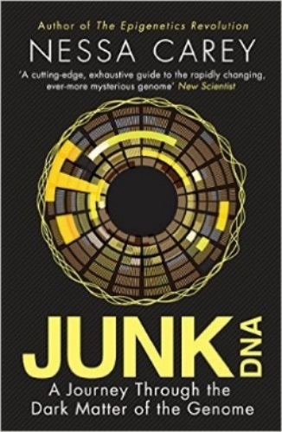
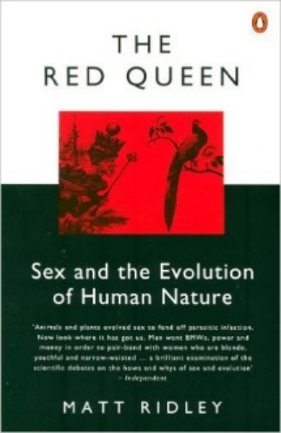
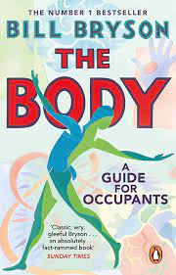
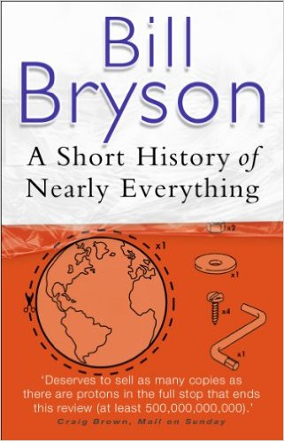
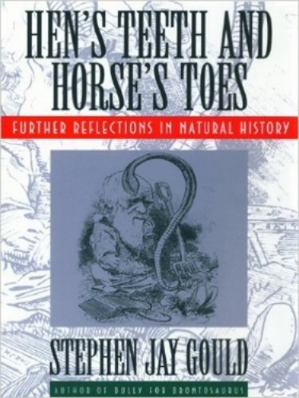
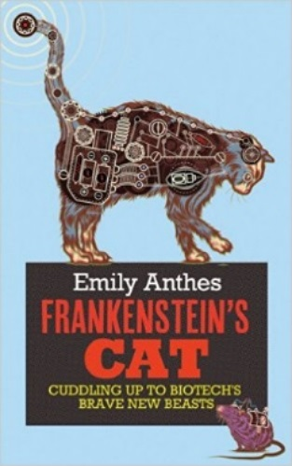
Option A: Book Recommendations
Kick back this summer with a good read. The books below are all popular science books and great for extending your understanding of Biology
The Red Queen
Its all about sex. Or sexual selection at least. This book will really help your understanding of evolution and particularly the fascinating role of sex in evolution. Available at amazon.co.uk
Junk DNA
Our DNA is so much more complex than you probably realize, this book will really deepen your understanding of all the work you will do on Genetics. Available at amazon.co.uk
Bill Bryson sets off to explore the human body, how it functions and its remarkable ability to heal itself. Full of extraordinary facts and astonishing stories The Body: A Guide for Occupants is a brilliant, often very funny attempt to understand the miracle of our physical and neurological make up.
A Short History of Nearly Everything
A whistle-stop tour through many aspects of history from the Big Bang to now. This is a really accessible read that will re-familiarise you with common concepts and introduce you to some of the more colourful characters from the history of science! Available at amazon.co.uk
Studying Geography as well?
Hen’s teeth and horses toes
Stephen Jay Gould is a great Evolution writer and this book discusses lots of fascinating stories about Geology and evolution. Available at amazon.co.uk
An easy read..
Frankenstein’s cat
Discover how glow in the dark fish are made and more great Biotechnology breakthroughs. Available at amazon.co.uk
© Copyright The PiXL Club Ltd, 2016

Slide 10
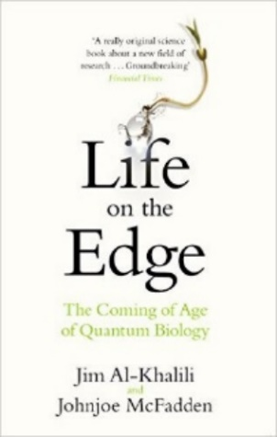
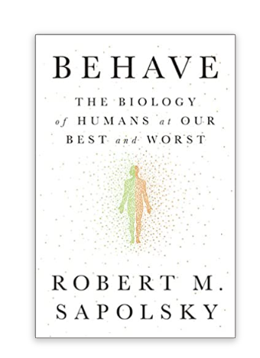
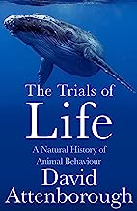
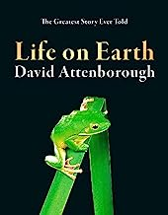
Option A: Book Recommendations cont.
Life is the most extraordinary phenomenon in the known universe; but how does it work? Even in this age of cloning and synthetic biology, the remarkable truth remains nobody has ever made anything living entirely out of dead material. Life remains the only way to make life. Are we missing a vital ingredient in its creation?
From the celebrated neurobiologist and primatologist, a landmark, genre-defining examination of human behaviour, both good and bad, and an answer to the question: Why do we do the things we do?
In Life on Earth, Sir David showed how each group of animals evolved. In Living Planet, he looked at the way they have adapted to the whole range of habitats in which they live. Now, in Trials of Life, he completes the story by revealing how animals behave – and why.
David Attenborough’s unforgettable meeting with gorillas became an iconic moment for millions of television viewers. Life on Earth, the series and accompanying book, fundamentally changed the way we view and interact with the natural world setting a new benchmark of quality, influencing a generation of nature lovers.

Slide 11

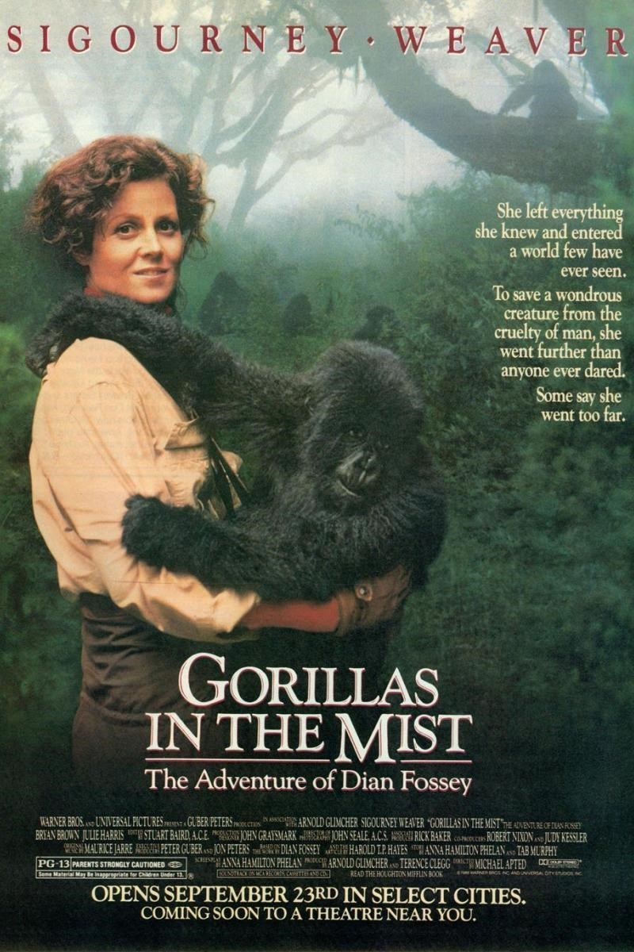

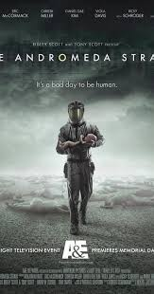
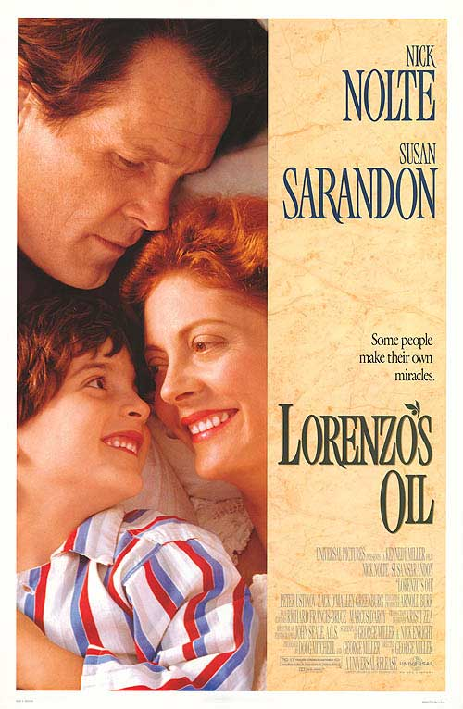
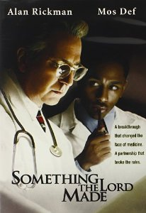
Option B: Movie Recommendations
Everyone loves a good story, and everyone loves some great science. Here are some of the picks of the best films based on real life scientists and discoveries. You won't find Jurassic Park on this list; we’ve looked back over the last 50 years to give you our top 5 films you might not have seen before. Great watching for a rainy day.
Gorillas in the Mist (1988)
An absolute classic that retells the true story of the life and work of Dian Fossey and her work studying and protecting mountain gorillas from poachers and habitat loss. A tearjerker.
Inherit The Wind (1960)
Great if you can find it. Based on a real-life trial of a teacher accused of the crime of teaching Darwinian evolution in school in America. Does the debate rumble on today?
Andromeda Strain (1971)
Science fiction by the great thriller writer Michael Cricthon (he of Jurassic Park fame). Humans begin dying when an alien microbe arrives on Earth.
Something the Lord Made (2004)
Professor Snape (the late great Alan Rickman) in a very different role. The film tells the story of the scientists at the cutting edge of early heart surgery as well as issues surrounding racism at the time.
Lorenzo’s Oil (1992)
Based on a true story. A young child suffers from an autoimmune disease. The parents research and challenge doctors to develop a new cure for his disease.
There are some great TV series and box sets available too, you might want to check out: Blue Planet, Planet Earth, The Ascent of Man, Catastrophe, Frozen Planet, Life Story, The Hunt and Monsoon.
© Copyright The PiXL Club Ltd, 2016

Slide 12

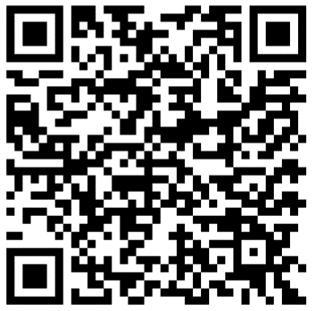


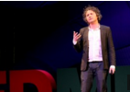
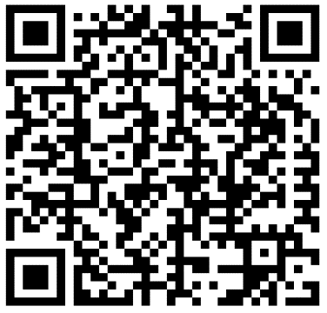
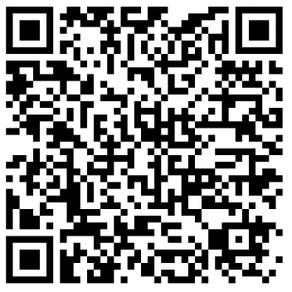
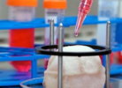
Option B: Movie Recommendations cont.
If you have 30 minutes to spare, here are some great presentations (and free!) from world leading scientists and researchers on a variety of topics. They provide some interesting answers and ask some thought-provoking questions. Use the link or scan the QR code to view:
A New Superweapon in the Fight Against Cancer
Available at : http://www.ted.com/talks/paula_hammond_a_new_superweapon_in_the_fight_against_cancer?language=en
Cancer is a very clever, adaptable disease. To defeat it, says medical researcher and educator Paula Hammond, we need a new and powerful mode of attack.
Why Bees are Disappearing
Available at : http://www.ted.com/talks/marla_spivak_why_bees_are_disappearing?language=en
Honeybees have thrived for 50 million years, each colony 40 to 50,000 individuals coordinated in amazing harmony. So why, seven years ago, did colonies start dying en-masse?
Why Doctors Don’t Know About the Drugs They Prescribe
Available at : http://www.ted.com/talks/ben_goldacre_what_doctors_don_t_know_about_the_drugs_they_prescribe?language=en
When a new drug gets tested, the results of the trials should be published for the rest of the medical world — except much of the time, negative or inconclusive findings go unreported, leaving doctors and researchers in the dark.
Growing New Organs
Available at : http://www.ted.com/talks/anthony_atala_growing_organs_engineering_tissue?language=en
Anthony Atalla's state-of-the-art lab grows human organs — from muscles to blood vessels to bladders, and more.
© Copyright The PiXL Club Ltd, 2016

Slide 13

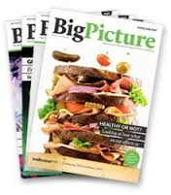
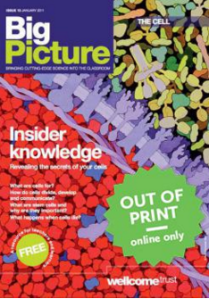

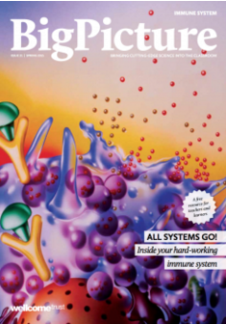

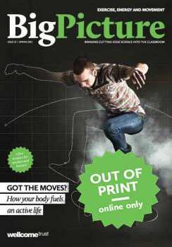

Option C: Research activities
Task: The Big Picture is an excellent publication from the Wellcome Trust. Along with the magazine, the company produces posters, videos and other resources aimed at students studying for GCSEs and A level.
For each of the following topics, you are going to use the resources to produce one page of Cornell style notes or a poster.
Use the links of scan the QR code to take you to the resources. Read the article.
Topic 1: The Cell
Available at: | STEM
The cell is the building block of life. Each of us starts from a single cell, a zygote, and grows into a complex organism made of trillions of cells. In this issue, we explore what we know – and what we don’t yet know – about the cells that are the basis of us all and how they reproduce, grow, move, communicate and die.
Topic 2: The Immune System
Available at: | STEM
The immune system is what keeps us healthy in spite of the many organisms and substances that can do us harm. In this issue, explore how our bodies are designed to prevent potentially harmful objects from getting inside, and what happens when bacteria, viruses, fungi or other foreign organisms or substances breach these barriers.
Topic 3: Space Biology
Available at: | STEM
Space biology looks at life in space from several perspectives: how it began, where it might be, and the effects of space as a rather extreme habitat on humans and other life.
© Copyright The PiXL Club Ltd, 2016

Slide 14
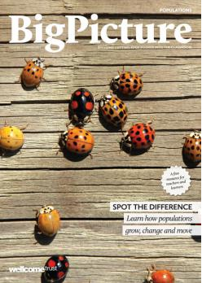

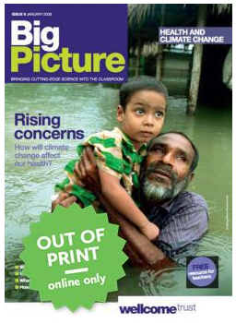

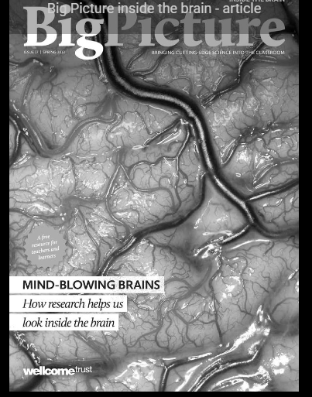
Option C: Research activities cont.
Topic 4: Populations
Available at: | STEM
What’s the first thing that pops into your mind when you read the word population? Most likely it’s the ever-increasing human population on earth. You’re a member of that population, which is the term for all the members of a single species living together in the same location. The term population isn’t just used to describe humans; it includes other animals, plants and microbes too. In this issue, we learn more about how populations grow, change and move, and why understanding them is so important.
explore how imaging research has changed the way we look inside one of our most fascinating organs, the brain. There is useful background information on MRI, fMRI, CT and PET scanning. This issue of the Big Picture looks at the basic structure and function of the brain, the use of functional and structural imaging in research, and some social, ethical and legal issues to do with the brain.
Topic 5: Health & Climate Change
Available at: | STEM
The Earth’s climate is changing. In fact, it has always been changing. What is different now is the speed of change and the main cause of change – human activities. This issue asks: What are the biggest threats to human health? Who will suffer as the climate changes? What can be done to minimise harm? And how do we cope with uncertainty?
Topic 6: Indside the brain
Available at: | STEM
Explore how imaging research has changed the way we look inside one of our most fascinating organs, the brain. There is useful background information on MRI, fMRI, CT and PET scanning. This issue of the Big Picture looks at the basic structure and function of the brain, the use of functional and structural imaging in research, and some social, ethical and legal issues to do with the brain.
© Copyright The PiXL Club Ltd, 2016

Slide 15
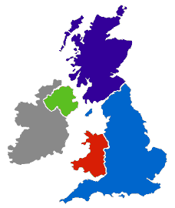
Option D: Ideas for Day Trips
If you are on holiday in the UK, or on a staycation at home, why not plan a day trip to one of these :
Glasgow Science Centre - Glasgow
Dundee Science Centre - Dundee
The Lakeland Wildlife Oasis - Milnthorpe
Scottish Seabird centre – North Berwick
W5 - Belfast
Life – Newcastle-upon-Tyne
Anglesey Sea Zoo - Anglesey
Cambridge Science Centre - Cambridge
Think-tank - Birmingham
Herriman Museum and Gardens - London
National Museum - Cardiff
The Eden Project - Cornwall
Centre of the Cell - London
Bristol Science Centre - Bristol
Royal Botanic Gardens – Kew - Edinburgh
The Living Rainforest - Newbury
Oxford University Museum of Natural History - Oxford
National Marine Aquarium - Plymouth
© Copyright The PiXL Club Ltd, 2016

Slide 16
Option D: Ideas for Day Trips cont.
If you are on holiday in the UK, or on a staycation at home, why not plan a day trip to one of these :
Remember there are also lots of zoos, wildlife and safari parks across the country, here are some you may not have heard of or considered:
Colchester Zoo, Cotswold Wildlife Park, Banham Zoo (Norfolk), Tropical Birdland (Leicestershire), Yorkshire Wildlife Park, Peak Wildlife Park, International Centre for Birds of Prey (York), Blackpool Zoo, Beale Park (Reading), Twycross Zoo (Leicestershire), Edinburgh Zoo (Edinburgh).
There are also hundreds of nature reserves (some of which are free) located all over the country including:
RSPB sites at Lochwinnoch, Saltholme, Fairburn Ings, Old Moor, Conwy, Minsmere, Rainham Marshes, Pulborough Brooks, Radipole Lake, Newport Wetlands.
Wildlife Trust Reserves and others at Rutland Water, Pensthorpe, Insh Marshes, Attenborough Centre, Inversnaid, Skomer, Loch Garten, Donna Nook, Chapmans Well, Woodwalton Fen, London Wetland Centre, Martin Down and Woolston Eyes Reserve.
Many organisations also have opportunities for people to volunteer over the summer months, this might include working in a shop/café/visitor centre, helping with site maintenance or taking part in biological surveys. Not only is this great experience, it looks great on a job or UCAS application.
For opportunities keep an eye out in your local press, on social media, or look at the websites of organisations like the RSPB, Wildlife Trust, National Trust or Wildlife & Wetland Trust.
There are also probably lots of smaller organisations near you who would also appreciate any support you can give!
© Copyright The PiXL Club Ltd, 2016

Slide 17


Option E: Science on Social Media
Science communication is essential in the modern world and all the big scientific companies, researchers and institutions have their own social media accounts. Here are some of our top tips to keep up to date with developing news or interesting stories:
Follow on Twitter:
Commander Chris Hadfield – former resident aboard the International Space Station @cmdrhadfield
Tiktaalik roseae – a 375-million-year-old fossil fish with its own Twitter account!
@tiktaalikroseae
NASA’s Voyager 2 – a satellite launched nearly 40 years ago that is now travelling beyond our Solar System
@NSFVoyager2
Neil dGrasse Tyson – Director of the Hayden Planetarium in New York
@neiltyson
Sci Curious – feed from writer and Bethany Brookshire tweeting about good, bad and weird neuroscience
@scicurious
The SETI Institute – The Search for Extra Terrestrial Intelligence, be the first to know what they find!
@setiinstitute
Carl Zimmer – Science writer Carl blogs about the life sciences
@carlzimmer
Phil Plait – tweets about astronomy and bad science
@badastronomer
Virginia Hughes – science journalist and blogger for National Geographic, keep up to date with neuroscience, genetics and behaviour
@virginiahughes
Maryn McKenna – science journalist who writes about antibiotic resistance
@marynmck
Find on Facebook:
Nature - the profile page for nature.com for news, features, research and events from Nature Publishing Group
Marin Conservation Institute – publishes the latest science to identify important marine ecosystems around the world.
National Geographic - since 1888, National Geographic has travelled the Earth, sharing its amazing stories in pictures and words.
Science News Magazine - Science covers important and emerging research in all fields of science.
BBC Science News - The latest BBC Science and Environment News: breaking news, analysis and debate on science and nature around the world.
© Copyright The PiXL Club Ltd, 2016

Slide 18
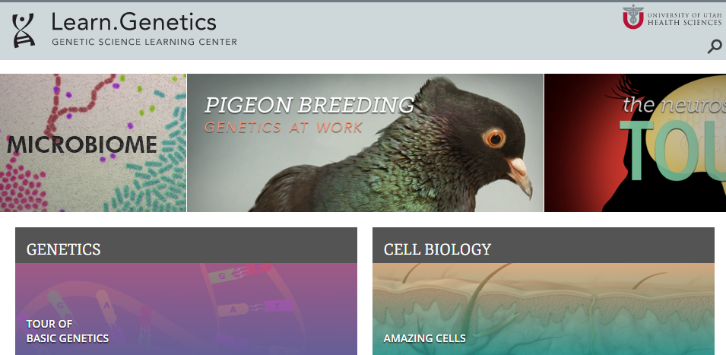

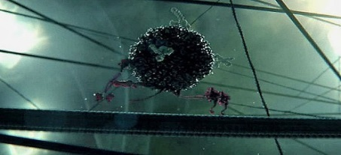
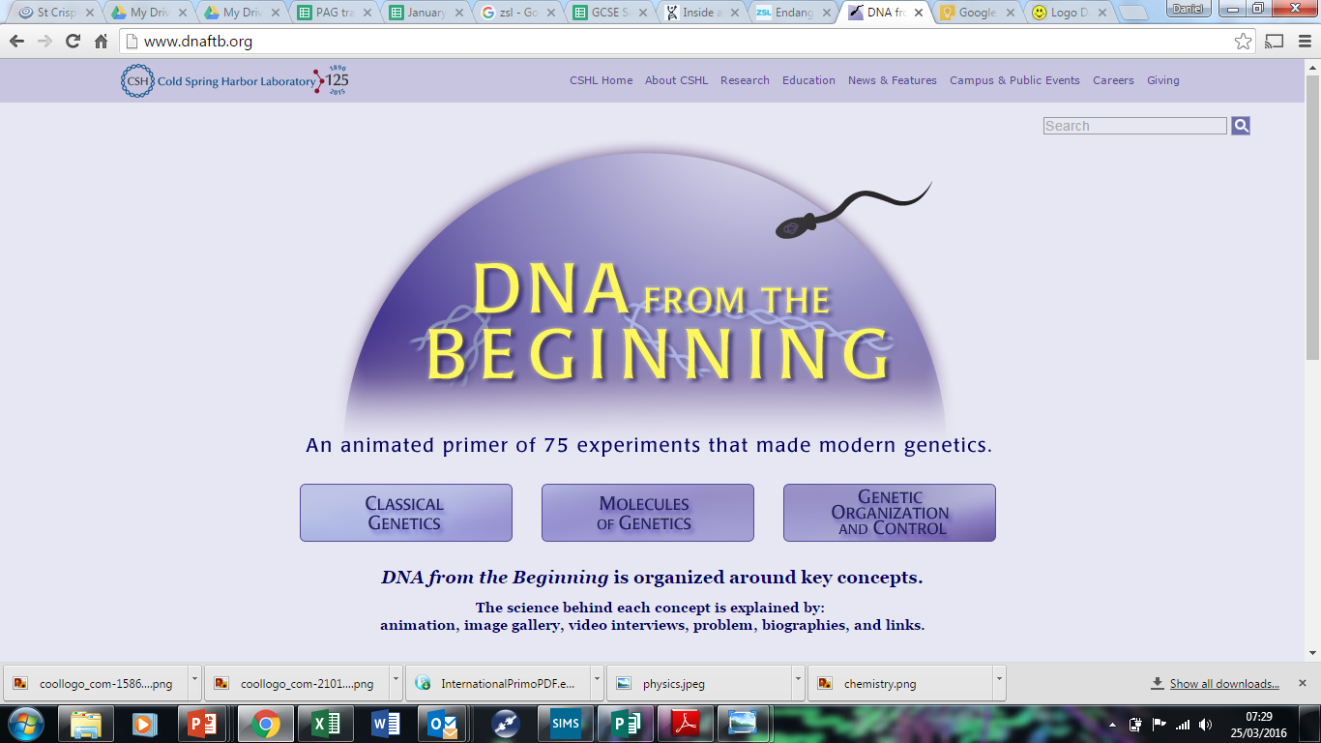


Option E: Science websites cont.
These websites all offer an amazing collection of resources that you should use again and again throughout your course.
Probably the best website on Biology….
Learn Genetics from Utah University has so much that is pitched at an appropriate level for you and has lots of interactive resources to explore, everything from why some people can taste bitter berries to how we clone mice or make glow in the dark jelly fish.
http://learn.genetics.utah.edu/
In the summer you will most likely start to learn about Biodiversity and Evolution. Many Zoos have great websites, especially London Zoo. Read about some of the case studies on conservation, such as the Giant Pangolin, the only mammal with scales. https://www.zsl.org/conservation
Ok, so not a website, but a video you want to watch. One of the first topics you will learn about is the amazing structure of the cell. This BBC film shows the fascinating workings of a cell… a touch more detailed than the “fried egg” model you might have seen.
http://www.dailymotion.com/video/xzh0kb_the-hidden-life-of-the-cell_shortfilms
If this link expires – google “BBC hidden life of the cell”
DNA from the beginning is full of interactive animations that tell the story of DNA from its discovery through to advanced year 13 concepts. One to book mark!
http://www.dnaftb.org/
Research | University of Oxford
Discover what Oxford University is currently researching.
Royal Society of Biology (rsb.org.uk)
Have a look at what is going on in the World of Biology
© Copyright The PiXL Club Ltd, 2016

Slide 19
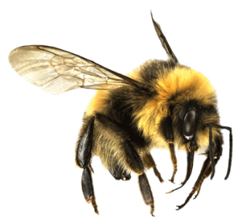


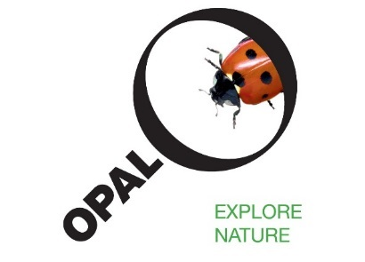






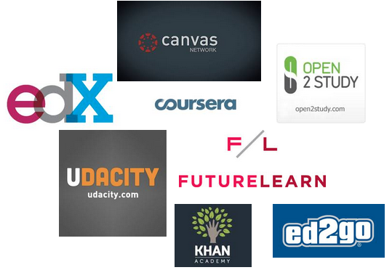
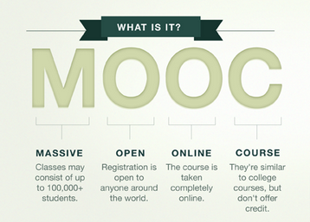
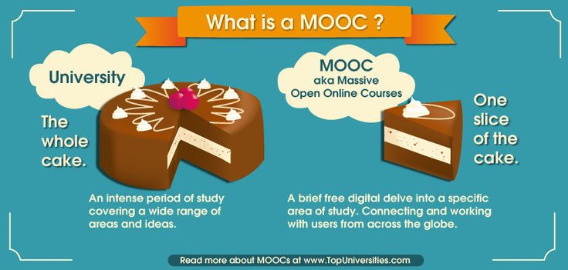
Option F Science: Things to do!
Day 4 of the holidays and boredom has set in?
There are loads of citizen science projects you can take part in either from the comfort of your bedroom, out and about, or when on holiday. Wikipedia does a comprehensive list of all the current projects taking place. Google ‘citizen science project’
Want to stand above the rest when it comes to UCAS? Now is the time to act.
MOOCs are online courses run by nearly all Universities. They are short FREE courses that you take part in. They are usually quite specialist, but aimed at the public, not the genius!
There are lots of websites that help you find a course, such as edX and Future learn.
You can take part in any course, but there are usually start and finish dates. They mostly involve taking part in web chats, watching videos and interactives.
Completing a MOOC will look great on your Personal statement and they are dead easy to take part in!
© Copyright The PiXL Club Ltd, 2016

Slide 20
Task 3: A Level Biology Transition Quiz
Task A - The following 40-minute quiz is designed to test your recall, analysis and evaluative skills and knowledge. Remember to use your exam technique: look at the command words and the number of marks each question is worth.
Task B – Mark and upgrade your answers using the suggested mark scheme provided for you.
a) What are the four base pairs found in DNA?
……………………………………………………………………………………………………………………………………………………………
(2)
b) What does DNA code for?
……………………………………………………………………………………………………………………………………………………………
(1)
c) Which organelle in a cell carries out this function?
…………………………………………………………………………………………………………………………………………………………..
(1)
2. a) What theory did Charles Darwin propose?
……………………………………………………………………………………………………………………………………………………………………….
(1)
b) Why did many people not believe Darwin at the time?
……………………………………………………………………………………………………………………………………………………………………….
(1)
c) Describe how fossils are formed.
……………………………………………………………………………………………………………………………………………………………………….
……………………………………………………………………………………………………………………………………………………………………….
……………………………………………………………………………………………………………………………………………………………………….
(3)
d) The fossil record shows us that there have been some species that have formed and some that have
become extinct.
i) What is meant by the term ‘species’?
……………………………………………………………………………………………………………………………………………………………………….
(2)
ii) Describe how a new species may arise:
……………………………………………………………………………………………………………………………………………………………………….
……………………………………………………………………………………………………………………………………………………………………….
…………………………………………………………………………………………………………………………………………………………………(3)
© Copyright The PiXL Club Ltd, 2016

Slide 21
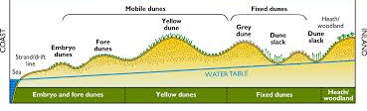
Ecologists regularly study habitats to measure the species present and the effect of any changes.
One team of ecologists investigated the habitat shown in the picture below:
Image taken from http://www.macaulay.ac.uk/soilquality/Dune%20Succession.pdf
a) Define the following keywords:
i) Population
………………………………………………………………………………………………………………………………………………………
ii) Community
………………………………………………………………………………………………………………………………………………………
(2)
b) Give an example of one biotic factor and one abiotic factor that would be present in this habitat
Biotic: ………………………………………………………………………………………………………………………………………………………
Abiotic: ………………………………………………………………………………………………………………………………………………………
(2)
c) Describe how the ecologists would go about measuring the species present between the coast and the inland.
……………………………………………………………………………………………………………………………………………………………………..
……………..………………………………………………………………………………………………………………………………………………………
……………………………………………………………………………………………………………………………………………………………………
…………..………………………………………………………………………………………………………………………………………………………
…………. ………………………………………………………………………………………………………………………………………………………
……………..………………………………………………………………………………………………………………………………………………………
(6)
© Copyright The PiXL Club Ltd, 2016

Slide 22
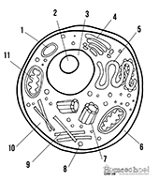
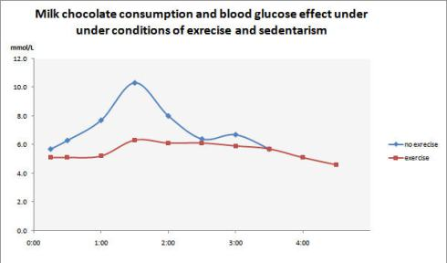
4. Every living organism is made of cells.
Image taken from http://prestigebux.com/worksheet/label-an-animal-cell-worksheet
a) Label the following parts of the animal cell:
2 ……………………………………………………………………………………………………………………………………………………………
5 ……..……………………………………………………………………………………………………………………………………………………
8 …………………………………………………………………………………………………………………………………………………………..
(3)
b) Describe how is the structure of the cell membrane related to its function?
…………………………………………………………………………………………………………………………………………………………………
…………………………………………………………………………………………………………………………………………………………………
…………………………………………………………………………………………………………………………………………………………………
(3)
5. A medical research team investigated how quickly the body deals with glucose after a meal. They studied the blood glucose concentration of people who exercised versus those who did not.
Here are their results:
Image taken from https://memoirsofanamnesic.wordpress.com/category/blood-glucose/
a) What organ in the body regulates blood glucose concentration?
…………………………………………………………………………………………………………………………………………………………………
(1)
Hours after eating
© Copyright The PiXL Club Ltd, 2016

Slide 23
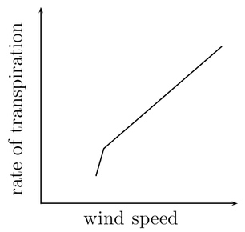
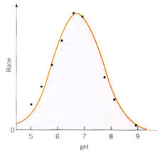
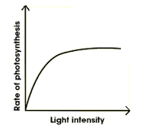
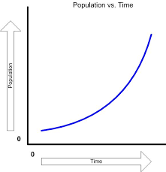
b) Explain how the stages that would bring about a return to normal blood glucose concentrations.
…………………………………………………………………………………………………………………………………………………………………
…………………………………………………………………………………………………………………………………………………………………
…………………………………………………………………………………………………………………………………………………………………
…………………………………………………………………………………………………………………………………………………………………
(4)
c) Name one variable the researchers will have controlled.
…………………………………………………………………………………………………………………………………………………………………
(1)
d) The researchers made the following conclusion:
“Blood glucose returns to normal values for all people after 4 hours”
To what extent do you agree with this conclusion.
…………………………………………………………………………………………………………………………………………………………………
…………………………………………………………………………………………………………………………………………………………………
…………………………………………………………………………………………………………………………………………………………………
…………………………………………………………………………………………………………………………………………………………………
(3)
Scientists need to be able to interpret data in graphs to decide if there are trends in the results.
For each graph bellow, describe the trend.
…………………………………………………………… ……………………………………………………………
…………………………………………………………… ……………………………………………………………(4)
Images taken from: http://www.everythingmaths.co.za/science/lifesciences/grade-10/05-support-and-transport-systems-in-plants/images/56aff2f9b6c5b041688f745ca928990c.png
http://www.bbc.co.uk/staticarchive/afa3f2b16b4d58d077943c96929c9a4020fea83a.gif
http://www.rpi.edu/dept/chem-eng/Biotech-Environ/Projects00/temph/enzyme.html
http://www.myearthwatchexperience.com/Essential%20Ecology.htm
© Copyright The PiXL Club Ltd, 2016

Slide 24
Suggested Mark Scheme:
Question |  |  | Answer | Marks
1 | a |  | Adenine-Thymine Cytosine-Guanine | 1 1
 | b |  | Protein/enzymes | 1
 | c |  | Ribosomes | 1
2 | a |  | Evolution (by natural selection) | 1
 | b |  | Not enough evidence | 1
 | c |  | (Plant/animal dies) and is quickly buried in sediment Not all conditions for decay are present Hard parts of the body are replaced by minerals | 1 1 1
 | d | i | Organisms that can reproduce to produce viable offspring/offspring that can also reproduce (fertile) | 1
 |  | ii | 3 from Geographical isolation/named example Mutation of genes Natural Selection/selective advantage Species can no longer interbreed (not produce fertile offspring) | 1 1 1 1
3 | a | i | A group of organisms, all of the same species, and all of whom live together in a particular habitat. | 1
 |  | ii | The total of all populations living together in a particular habitat. | 1
 | b |  | Biotic – one from: Predators, prey, plant, microbes Abiotic – one from: Availability of water, temperature, mineral concentration, reference to climate/weather | 1 1
 | c |  | Measure out a transect Using a tape measure Use a quadrat At regular (named) intervals Identify species present Using a key/guide | 1 1 1 1 1 1
4 | A |  | 2 Nucleolus 5 Smooth Endoplasmic Reticulum 8 Golgi body | 1 1 1
© Copyright The PiXL Club Ltd, 2016

Slide 25
Question |  |  | Answer | Marks
4 | b |  | Any 3 from the following structure and function must be given. Lipid bilayer - has a hydrophobic inside and hydrophilic outside, allowing for selective permeability Proteins - allow for specific substances to come or some molecules to pass through, Cholesterol - allows for fluidity of the membrane, Glycoproteins - for cell identification they serve as markers | 1 1 1 1
5 | a |  | Pancreas | 1
 | b |  | 3 from Pancreas detects change Insulin secreted By alpha cells Respiration increased Uptake of glucose increased Liver increases storage of glucose as glycogen | 1 1 1 1 1 1
 | c |  | Any one from: Amount of chocolate, time taken to eat, other food/drink consumed, age, gender, weight, fitness level/metabolic rate, health/pre existing conditions, use of medicines/drugs | 1
 | d |  | Any three from Data suggests that blood glucose returns to normal Doesn’t show how much exercise has been done Doesn’t say age/gender/other named variable May only be true for chocolate/only one type of food investigated | 1 1 1 1
6 |  |  | Top left: transpiration increases when wind speed increases/there is a positive correlation Top right: rate increases with pH until the optimum is reached, after the optimum, rate decreases Bottom left: Increasing light initially increases the rate of photosynthesis, but after a while remains constant Bottom right: Population increases slowly at first and then increases at a greater rate/increases exponentially | 1 1 1 1
© Copyright The PiXL Club Ltd, 2016

Slide 26
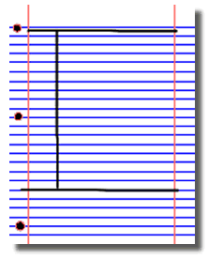

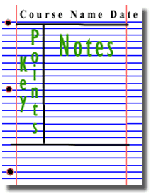
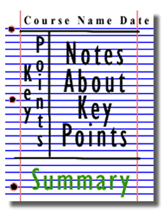
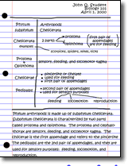
Research activities
Research, reading and note making are essential skills for A level Biology study. For the following task you are going to produce ‘Cornell Notes’ to summarise your reading.
1. Divide your page into three sections like this
2. Write the name, date and topic at the top of the page
3. Use the large box to make notes. Leave a space between separate idea. Abbreviate where possible.
4. Review and identify the key points in the left hand box
5. Write a summary of the main ideas in the bottom space
Images taken from http://coe.jmu.edu/learningtoolbox/cornellnotes.html
© Copyright The PiXL Club Ltd, 2016

